Slide 1

University campus network
BY-
Anisha Agarwal
Pooja Shekhar

Slide 2

Content
Overview
Implementation
Drawbacks in other system
Conclusion
Live Demonstration
References

Slide 3
Why is Campus networking used??
To connect different departments, users, and buildings within a campus.
Used for providing seamless connectivity and reliability to users within the campus network.
It is maintained, designed by centralized IT department.

Slide 4
Network Protocols and topologies Used
VLAN
RIP
Static Routing
DHCP Server

Slide 5
VLAn
A VLAN (Virtual Local Area Network) is a network topology that enables the creation of logical networks within a physical network infrastructure. VLANs allow network administrators to group devices together based on their functional roles or locations, regardless of their physical locations within the network.
In a VLAN, devices that are part of the same logical network can communicate with each other as if they were connected to the same physical switch, even if they are physically connected to different switches. This is achieved by tagging packets with a VLAN ID, which allows switches to identify which devices belong to which VLAN.

Slide 6
RIP
RIP is used to exchange routing information between routers in a network and determine the most efficient paths for data to travel from one network to another.
RIP version 1 is a classful protocol, which means that it only supports the original IP addressing scheme with its default subnet mask.
RIP version 2 is a classless protocol, which supports variable-length subnet masks (VLSM) and allows for more efficient use of IP address space.

Slide 7
DHCP Server
Dynamic Host Configuration Protocol (DHCP) is a network management protocol that automates the assignment of IP addresses and other network configuration parameters to devices on a network. With DHCP, a server dynamically assigns IP addresses to devices as they connect to the network, eliminating the need for manual IP address configuration.
When a device connects to a network configured with DHCP, it sends a request for network configuration information to a DHCP server. The DHCP server then assigns the device an available IP address from a pool of addresses that it manages. The DHCP server also provides the device with other network configuration information such as the subnet mask, default gateway, and DNS server addresses

Slide 8
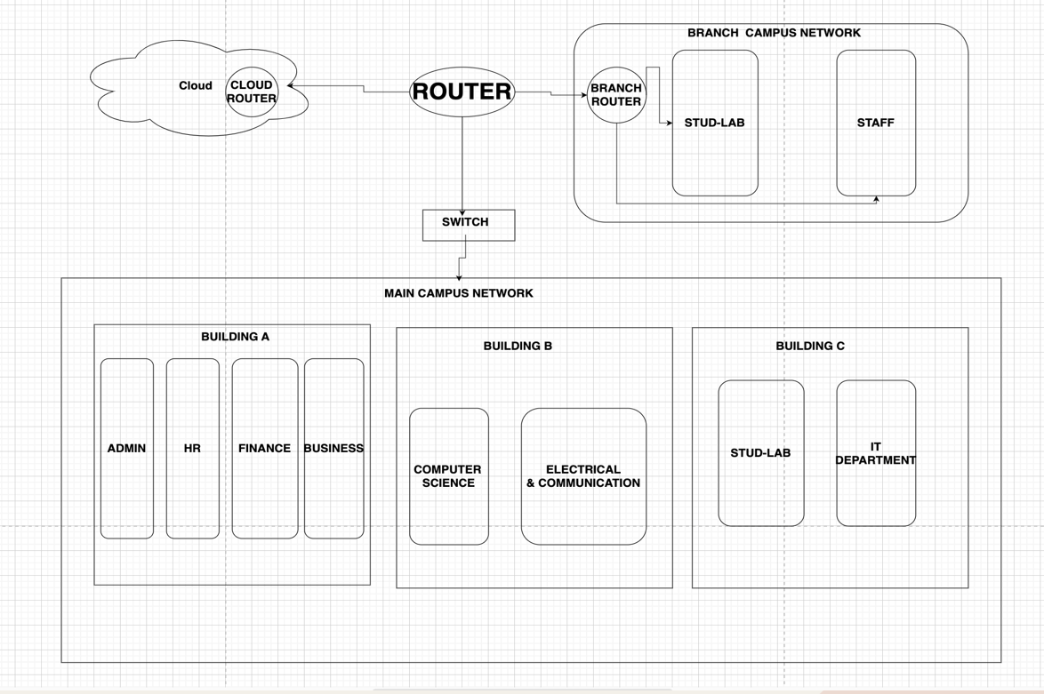
Idea

Slide 9
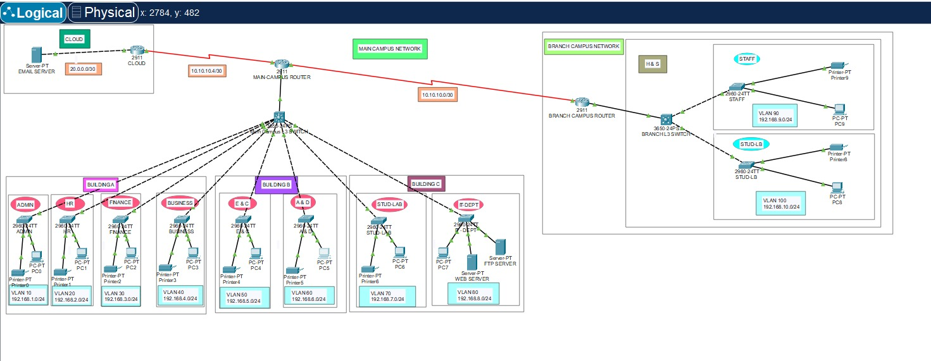
sIMULATIONs (Example 1)

Slide 10
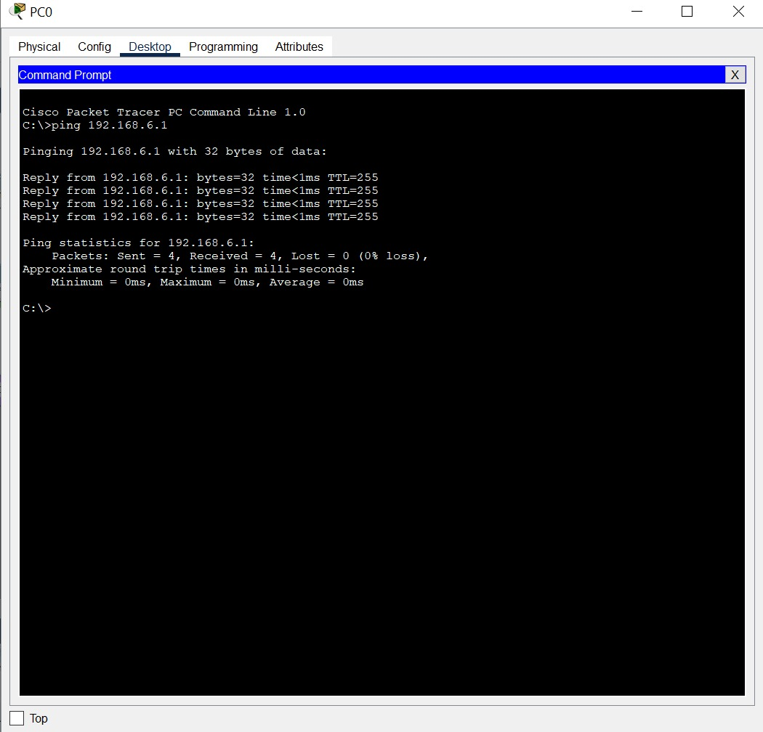
COMMANDS

Slide 11
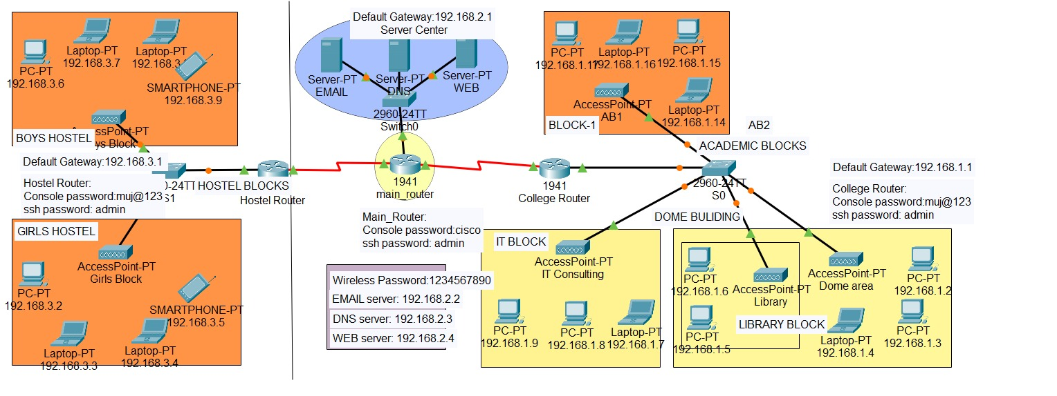
Example 2

Slide 12
Comparison Between tHE DESIGNS
Example 1:
Since the branch campus is connected to the main campus with the help of main router, we can easily ping any PC that is located in the main campus.
And the main router is connected to cloud so we can easily retrieve any data from cloud.
Example 2:
In this example since the branch campus is not connected to the main campus router, we cannot ping any device that is in the main campus.
Also, the main campus router is not connected to the cloud so we cannot retrieve data.

Slide 13
Conclusion
After seeing all the three examples, we can conclude that example 1 is the best design as it is connected properly to both the campuses as well as the cloud.
So, there won’t be any problem in connecting to any device in any campus and department.
Also, the retrieval of data would be easier if data is lost due to any reason, as all the data is stored on the cloud.

Slide 14
Live Demonstration

Slide 15

References
Virtual local area network technology and applications by V. Rajaravivarma (https://ieeexplore.ieee.org/document/581577)
Designing a hierarchical DHCP server's model to automatically provide dedicated IP address anywhere in the world with mobility by Asjad Amin; Haseeb Ahmed (https://ieeexplore.ieee.org/document/6148452)
Performance evaluation of routing protocol RIPv2, OSPF, EIGRP with BGP by Siti Ummi Masruroh; Andrew Fiade(https://ieeexplore.ieee.org/document/8319134)

Slide 16
THANK YOU!!!!!

